Slide 1

A Dive Into Data Sets:
SleepStudy
By: Hailey Bauer and Nolan Nguyen
COP2073

Slide 2

Describe the research question
College students often have lots of assignments to do, early classes, and many other activities that occupy their time. Each of these factors influence their sleep and therefore their mental and physical health, as well as academic performance.
We strive to discover how these factors influence students through the following research question:
What is the distribution of sleep quality among college students and are there any significant factors affecting sleep quality and is there a correlation between the number hours slept and cognitive function scores on the skill test?
With the use of the Data Set: SleepStudy, which investigates 254 surveyed students considering characteristics such as the quantity of early classes taken, GPA, quantity and quality of sleep, depression score, anxiety score, stress score, etc. we will explore the aforementioned research question.

Slide 3

Data Exploration
Categorical:
- Depression Status - Anxiety Status - Stress Level Quantitative:
- Average Sleep - Sleep Quality - Alcoholic Beverages Consumed
Method: Created boxplots, scatterplots, and histograms using the package “ggplot”.

Slide 4
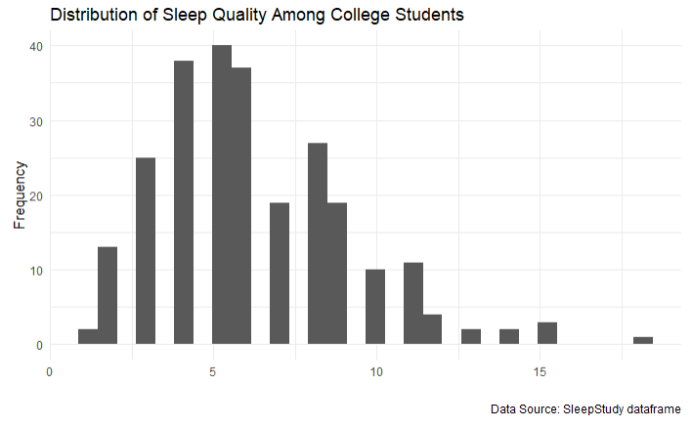
Univariate Exploration Data

Slide 5
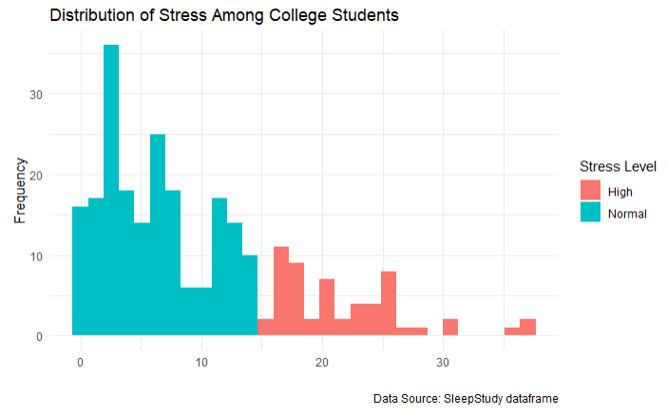
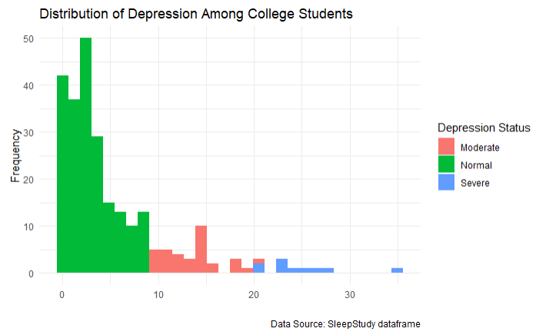
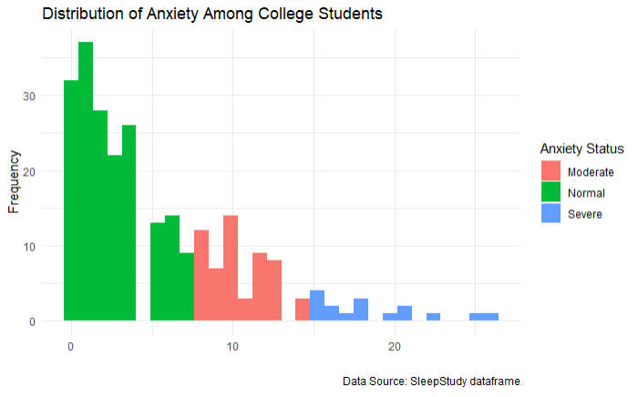

Slide 6
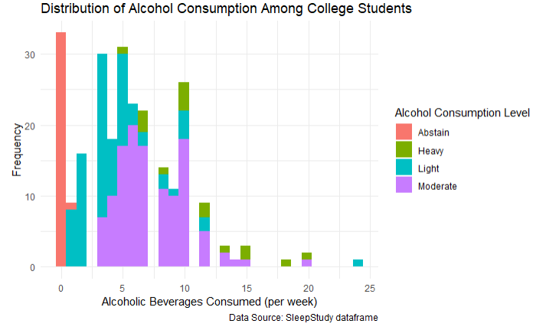

Slide 7
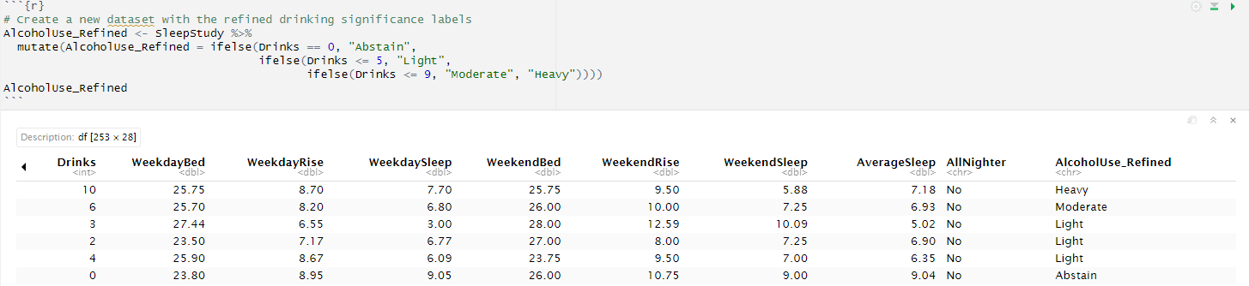
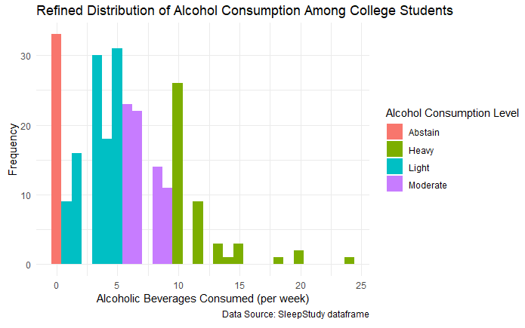

Slide 8
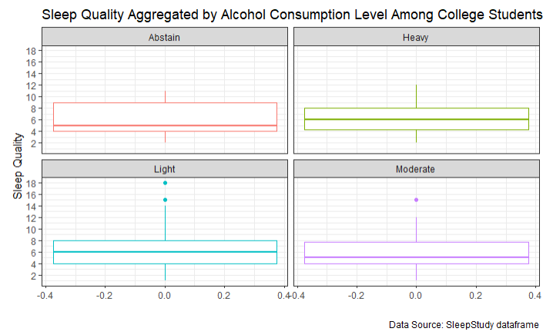
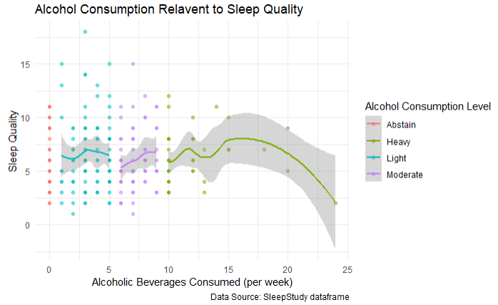
Multivariate Exploration Data

Slide 9
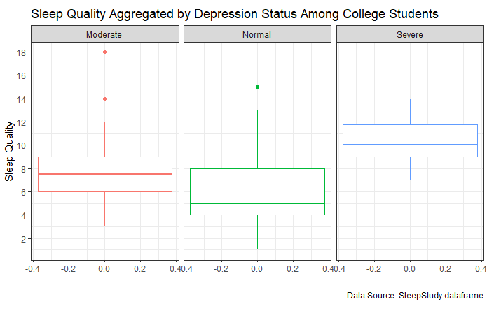
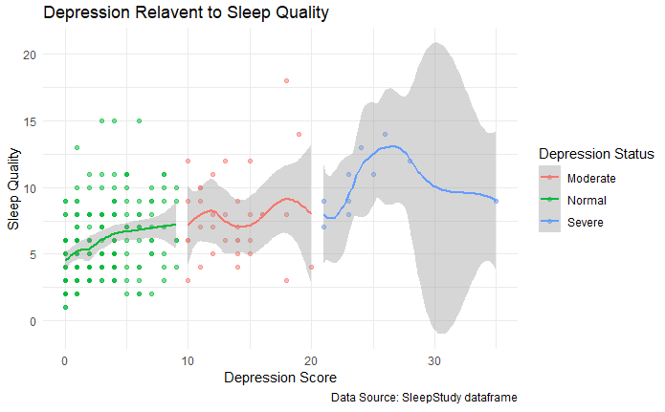

Slide 10
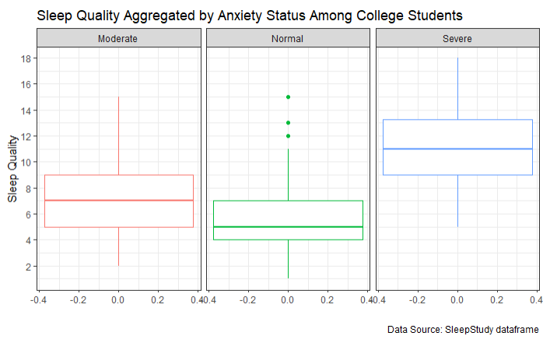
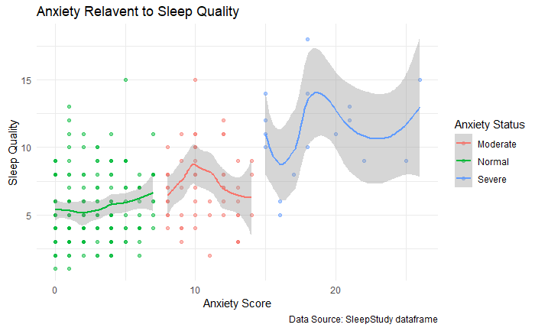

Slide 11
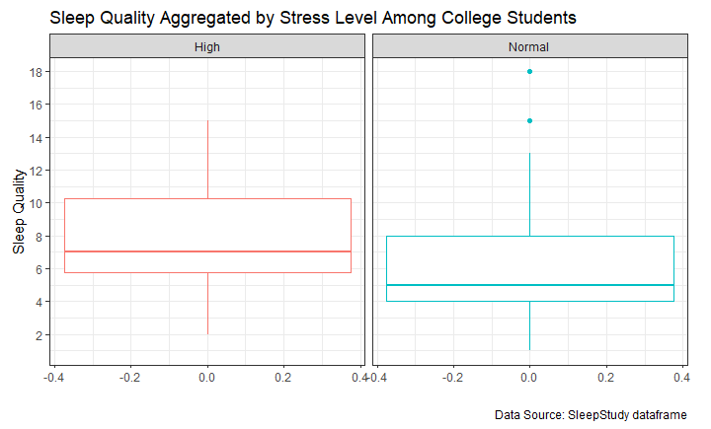
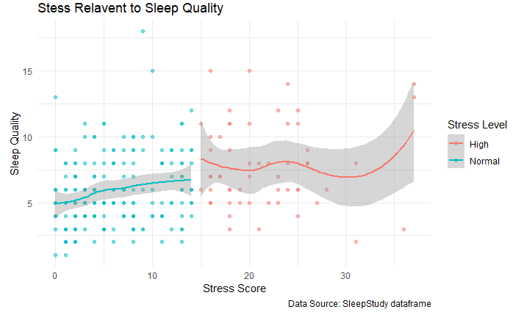

Slide 12
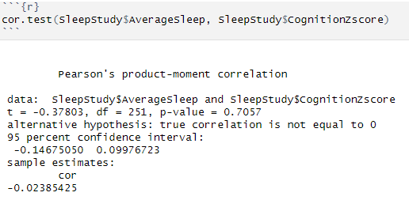
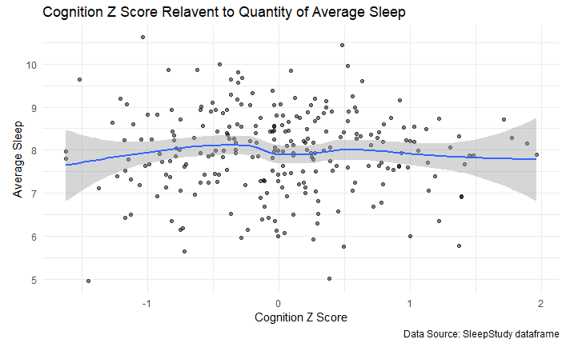

Slide 13

What Did We Conclude?
To conclude, through the utilization of R programming to analyze and visualize our dataset, encompassing the creation of various graphs as presented, we have identified several noteworthy variables—Depression, Anxiety, Stress, and Alcohol Use—each exerting an influence on sleep quality.
Furthermore, our analysis has revealed a negative correlation between the number of hours slept and cognitive function scores on the skill test.

